Slide 1
Windyfi
Democratizing Project Development within Wind Industry
1

Slide 2
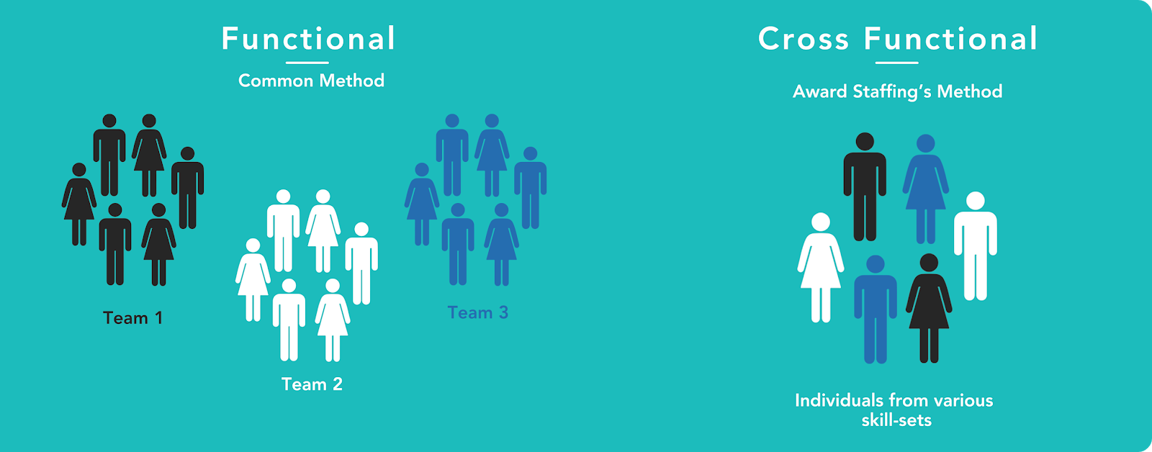
Big projects within onshore wind similar to other construction projects suffer from delay and cost overruns due to inability to see complete project overview early enough and poor cross-disciplinary collaboration in the process.
The main problem
2

Slide 3
Wind farm developers may lose a lot of value in the process of taking their development to the next stage due to improper definition of trade-offs early in the process.
The main problem
Windyfi
3

Slide 4
The main problem
Early stage
Late stage
Under construction
Installed
Scenario 1
Project development and maturation
Approved & ready for construction
Assets in operation
Scenario 2
Wind project value
Optimal decisions early in the process can set the trend for later stages, but developers or sponsor may lack the fund
At this stage some of the decisions are difficult and/or more costly to change due to conceptual lock (permitting) and that its too late
Scenario 3
4
Wind Project lifecycle
Optimal early stage decisions to increase revenue and lower capital expenditure
High value
Middle value
Low value
Notes:
Source: Deloitte (2020) – “A Brand New Merchant World – Perspectives and Transaction Analyses for Renewable Energy Market Approach for Valuing Onshore Wind Farm Assets”

Slide 5
Why now?
542 GW to 5044 GW Increase
Installed capacity of onshore wind is expected to grow more than 3x by 2030 and 10x by 2050*
146 Billion dollar annual investment by 2030
More than half of the growth will occur in developing markets, which traditionally struggle more with large scale infrastructure projects
Capacity increase to 58%
The global weighted average capacity factor for new turbines has increased from 27% in 2010 to 34% in 2018 and would increase to 58% by 2050
Taller and bigger turbines )
Text
Text
Text
5
Optimal early stage decisions to increase revenue and lower capital expenditure
High value
Middle value
Low value
Notes:
Source: Deloitte (2020) – “A Brand New Merchant World – Perspectives and Transaction Analyses for Renewable Energy Market Approach for Valuing Onshore Wind Farm Assets”

Slide 6
Why now
From 542 GW to 5044 GW | Installed capacity of onshore wind is expected to grow more than 3x by 2030 and 10x by 2050*
146 Billion dollar annual investment by 2030 | More than half of the growth will occur in developing markets, which traditionally struggle more with large scale infrastructure projects
Capacity increase to 58% | The global weighted average capacity factor for new turbines has increased from 27% in 2010 to 34% in 2018 and would increase to 58% by 2050
6
*Future of Wind, IRENA
Notes:
https://irena.org/-/media/Files/IRENA/Agency/%20Publication/2019/Oct/IRENA_Future_of_wind_2019.pdf

Slide 7
Cause of challenges
86% of executives and employees blame a lack of collaboration or bad communication for team problems and failures.
Wind farm project data within different workstreams are kept in silos and as a result, employees have a hard time to have the most recent updated data to make effective decisions
Poor use of unsynchronised data flows as well as contextualizing what it means for the project in the long terms
Conceptual lock in at early stage due to fixed location permitting means that value-adding decisions need to be done early enough
7

Slide 8



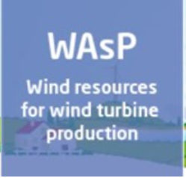






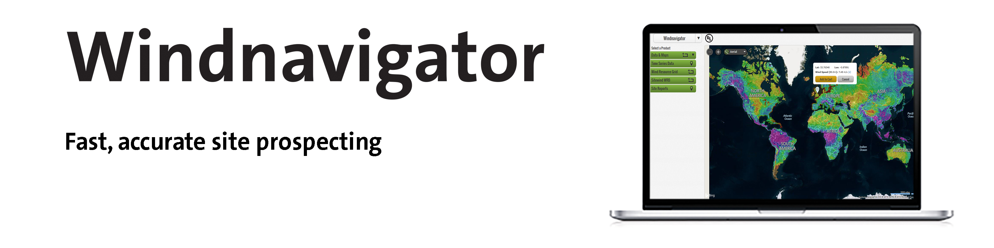


Competition
Multi-dimensionality
Windyfi
Specialized training
Ease of use
Focus on one element

Slide 9
Windyfi
Environment & Social
and Permitting
Land allocation
General layout
and micrositing
Wind Farm
Development
WTG selection and
civil infrastructure
Yield curve and
power generation
Grid capacity and
electrical design
9
Notes:
9

Slide 10
Mission/Vision
Windyfi
Build an interactive and easy to use tool that can help wind farm owners to realize a long term value.
Helping project developers make the optimal early trade-offs through technology.

Slide 11
Uncertain projects and difficult to assign value in regression
Value increases as developers obtain permits from local authorities, secure turbines, debt financing, etc.
Larger variance compared to later stages due to projects early vs. late in the phase
Variance largely explained by other factors than capacity, such as age, local wind conditions, operating efficiency, PPA, tax, subsidies, financing
Value increases the most during the construction phase until COD as project costs are incurred
11

Slide 12
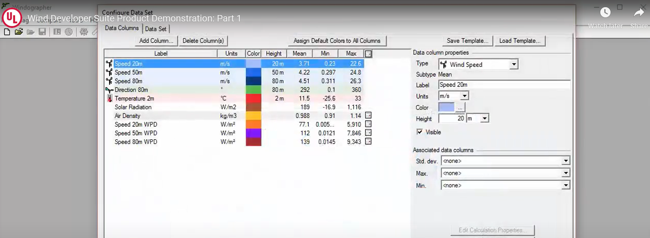

Existing softwares within wind-industry are like from 80-s and suck, require a lot of specialized knowledge, focused on wind data and yield mostly, there is no interdisciplinary complete farm overview
The problem 2
WindPark Builder

Slide 13

Cross-disciplinary issues in the development of the wind farm given that every part of the project affects everything else and it is difficult for a person from one discipline to see the impact of decision on another
The problem 3
WindPark Builder

Slide 14
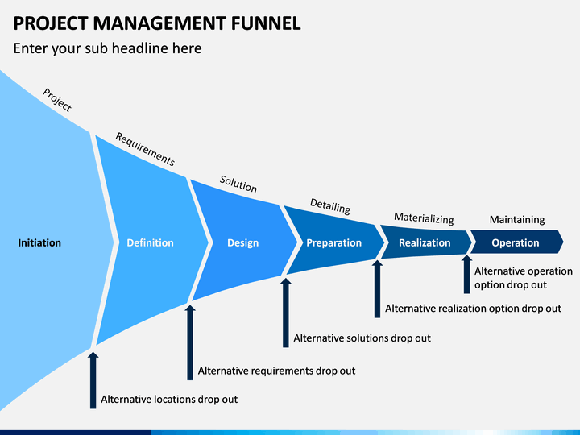
Lack of user-friendly tools to visualize the wind farm and all of its related BoP infrastructure to various stakeholders easily Lack of easy to use tools to screen the projects in the pipeline fast enough and get sufficient information to proceed with a decision
The problem 3
WindPark Builder

Slide 15
The market 1
WindPark Builder
Lowering cost of onshore and offshore wind energy
Larger turbines have a capacity factor over 50%, but also means bigger logistical challenges i.e requires better planning
Current installed capacity around the world 700 GW and in 2035 is predicted to reach 2000 GW with 80% being Onshore
Increasing share of corporate PPAs
Increasing demand for electricity in emerging and developing countries, where large project development is complex

Slide 16
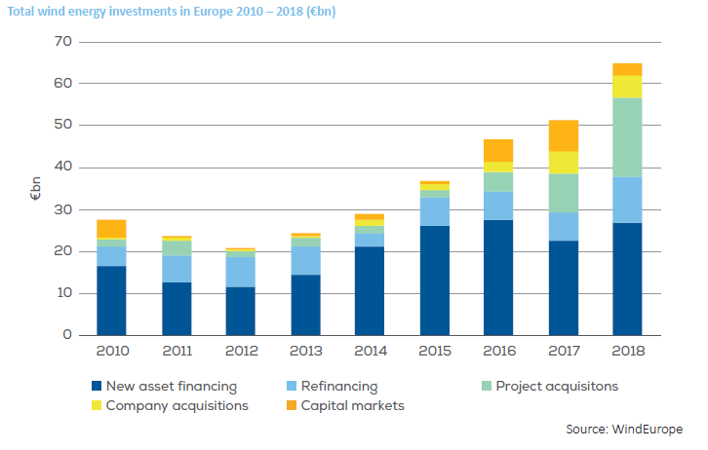
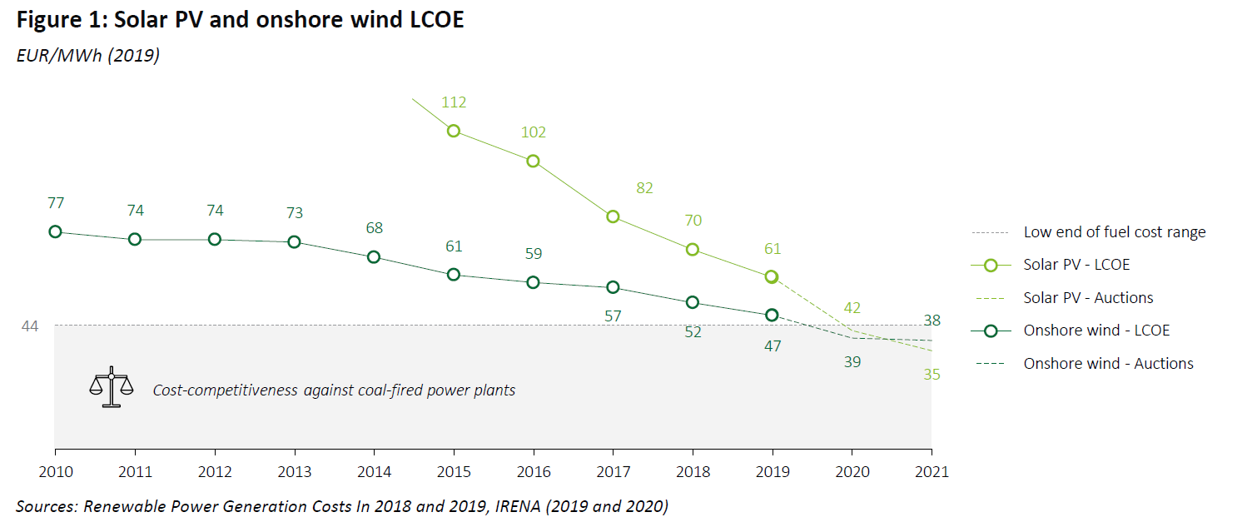
WindPark Builder
The market 2
Onshore wind energy is the competitive form of energy and dependency on subsidies has decreased substantially recently -> evolution from niche market to mature mainstream means that they have to become better at it
The cost of onshore wind (LCOE) has been decreasing and now is below coal
Investments in wind energy are increasing fast and further are estimated to increase by 3x in 2035

Slide 17
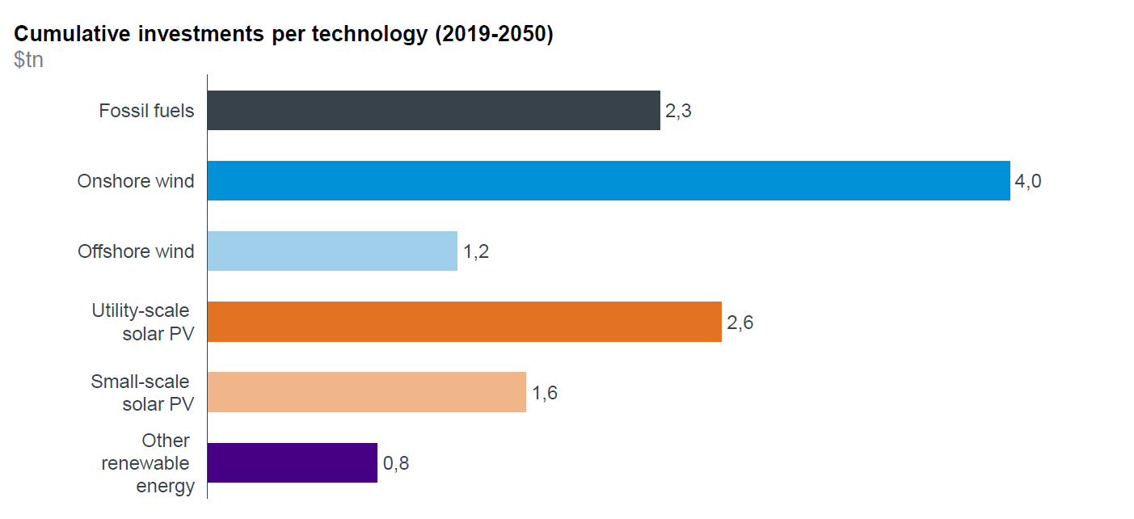
Windyfi
The market 3

Slide 18
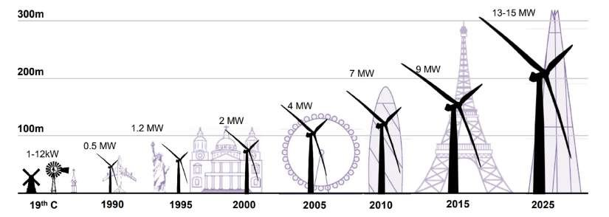
WindPark Builder
The market 3
Larger turbines have a capacity factor over 50%, but also means bigger logistical challenges i.e requires better planning

Slide 19
WindPark Builder
Target audience
Small developers, especially those with stronger commercial/finance focus and weaker technical capabilities
Large developers (corporations) that have challenges within interdisciplinary collaboration and or utilities that have major cross-departmental challenges within the wind farm development
WTG suppliers who also develop their own projects as well as all other relevant stakeholders within wind supply chain (transportation companies, installation, BOP contractors etc. )
New entrants in the market such as big utilities or oil companies who are less experienced with the challenges of an industry
Financiers in the wind industry (lenders, funds, multilateral banks etc.)
Energy enthusiasts and within energy education field (university, high-school)

Slide 20




















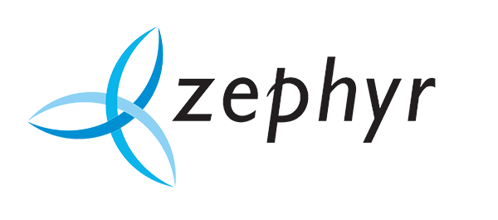


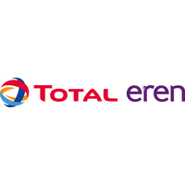




















WindPark Builder
Small Developers
Utilities and oil supermajors
Service/construction companies
WTG suppliers

Slide 21
WindPark Builder
Competition
Shallow
Broad
Wind
Depth of
Specialized
Solar
Deep
Low
High
Ease of use

Slide 22
Header | Text Text Text
Header | Text Text Text
Header | Text Text Text

Slide 23
WindPark Builder
Competition

Slide 24
Solar
?
Easy to use, user-friendly
more general audience
Ease of Use
Specialized knowledge required -
Specialists with domain knowledge required
Deep with one theme focus
Basic with broad range of coverage
Specialized
(market share)
WindPark Builder
Notes:
24

Slide 26

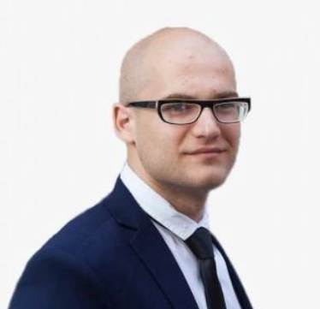
The team
Hustler (CEO)
Hacker (CTO)
Data geek (CDO)
3 yrs within oil and gas and wind project developments (1.5 GW)
2 yrs working experience within
MSc in Strategy and Management (minor in Finance)
BA in Economics and Classical Languages
10 yrs within renewable developments
Design, Construction and Operation of 0.5 GW
Ph.D in Renewable Energy
MSc in Power Engineering

Slide 27
WindPark Builder
Business model
Generating reports – the more advanced reports require higher pay
Other ways to monetize to be researched further:
Ability for developers to find suppliers; suppliers pay to be listed in there – i.e industry marketplace
Drone based survey over the site
Freemium version with limited opportunities to drive growth
Subscription based model with price discrimination (the price of membership depends on revenue of the company i.e more revenue means higher price)
Advanced tailor made services
Recurring payments

Slide 28
WindPark Builder
Features
Input:
Output
Location of WTGs (x,y) and relevant infrastructure (substation and transmission line, if applicable)
WTG model (all available information from WTG Manufacturer) and its relevant Site Specific Requirements
Environmental and Social constraints as well as other site constraints
Wind information and other electricity cost information to generate the reports
Map based interactive tool to complete input information with real data on the ground (Google Earth and/or other publicly available information such as wind, elevation, distance to population etc.)
Auto-generated output such as:
General layout that contains all visualized output (3D WTGs, roads, cables, substation and transmission line)
Basic Project Information report that includes:

Slide 29
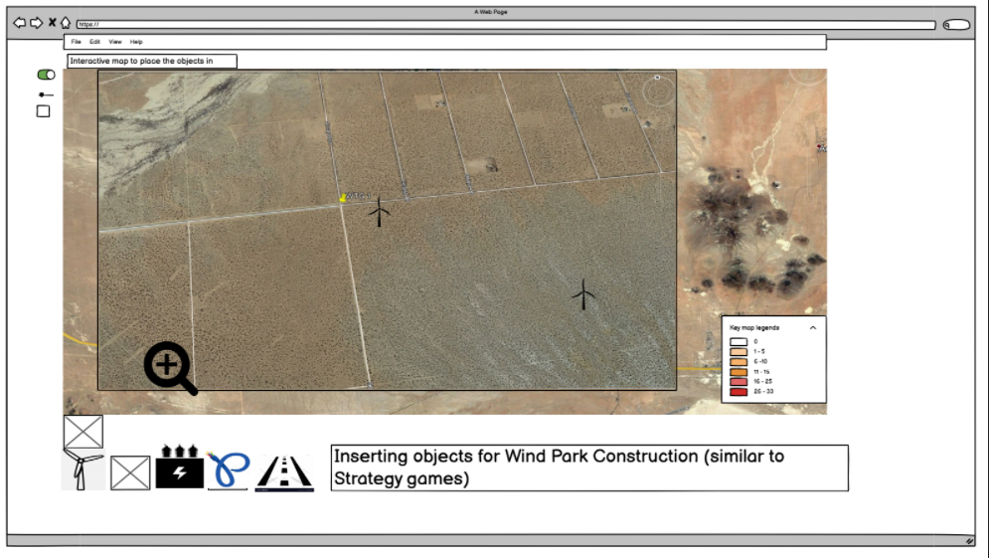
WindPark Builder
MVP

Slide 30
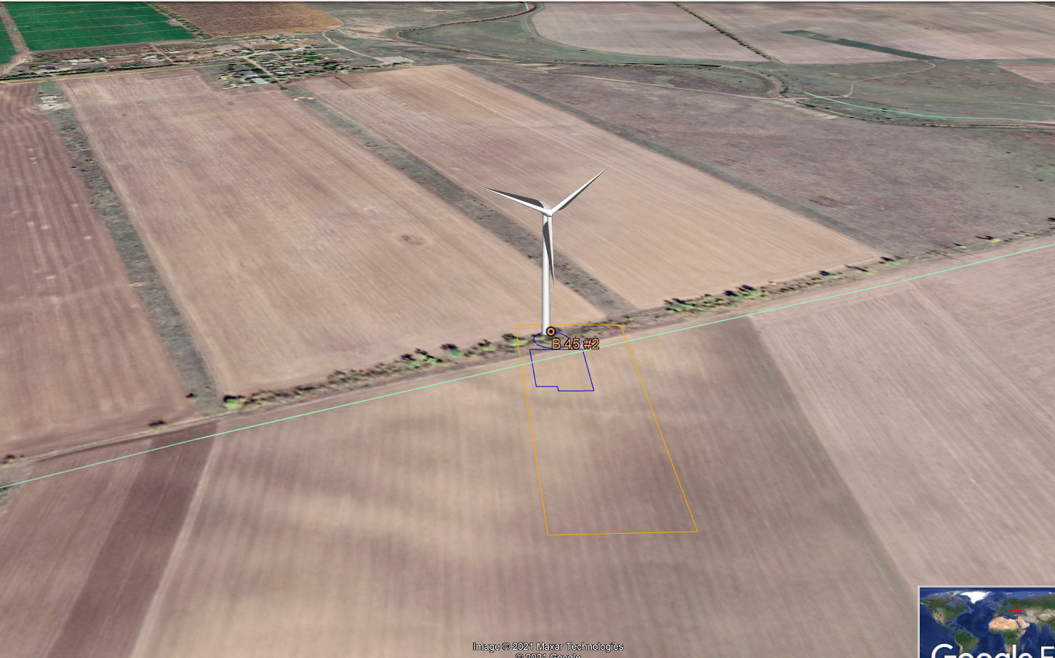
Output

Slide 31
Wind development process chain
Initiation
Consenting
Construction
Operations
Site selection
Project feasibility
Scoping & Consultation
Maturation
Consenting
Project confirmation & Early works
Construction
O&M
Upgrading or decommission
Evaluate wind potential and ground surface
Ascertain potential critical impediments to development
Assess access for wind farm and transmission infrastructure
High level investigations into site constraints and regulatory approval processes
Assess land availability and consult with land-owner (Private or government)
Perform WRA
Understand project design options and anticipated CAPEX
Pre-design layout and feasibility concept
Confirm project feasibility
Understand regulatory approval processes
Understand parameters for (EIA)
Initiate early consultation with key stakeholders
Scope access for wind farm and transmission infrastructure
Understand project design options and anticipated development costs
Identify and consult with key suppliers
Detailed site-specific investigations for EIA preparations
Start initial community engagement and/or consultation
Initiate EIA & consent process
Optimize the site design
Initiate EPC tendering
Secure off-take/power purchase agreement
Pre-application consent administration matters and information requirements clarified with consenting authorities
Draft documentation prepared and peer reviewed if relevant
Finalize and optimize project design
Secure access rights and other permits
Finalize EPC contracts
Finalize project business case
Secure financing
Receive formal consent
Lay access tracks
Construct foundations
Erect turbines
Connect site to grid network / substation
Construction of facilities,
Off site fabrication and site preparation
Prepare, implement and monitor environmental management plans in accordance with consent condition
Ongoing stakeholder and community engagement
Operate & Maintain wind farm components, as required
Monitor and comply with consent conditions and management plans
Upgrade wind farm
Remove infrastructure and rehabilitate land
Activities carried out in accordance with applicable consent conditions or environmental management plans
Stakeholder and community engagement
6 – 12 months
18 – 24 months
18 – 48 months
6 – 12 months
6 – 12 months
12 – 24 months
10-20+ years
2-3 years
2-5 years
2-3 years
15-20% (of total CAPEX)
10-15%
60-80%
OPEX
Wind (we need to go where the resource is)
Land (we need willing landowners)
Permits (we need to get the necessary approvals and consents)
Transmission (we need to get the capacity and proximity)
Buyer (we need someone who buys our product)
Financing (all the above is need to finance the project)
Sure, we can do that!
Natural fit for bolt-on undertaking

Slide 32
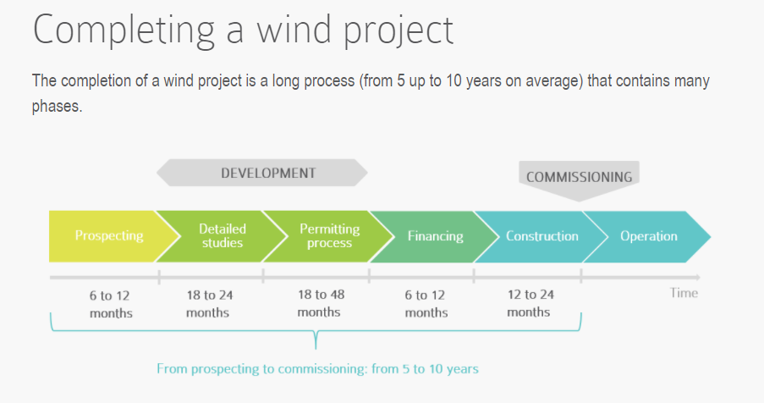
WindPark Builder

Slide 33
WindPark Builder
Prospecting
The initial phase of the process is prospecting. It involves identifying a site that presents the necessary qualities to install a wind farm, to approve it and to secure it.
In the first step, the local officials grant authorization to initiate a wind project on their land then promissory leases are signed with the landowners and farmers for a length of time that allows to cover the time for obtaining the building permit or equivalent authorization. The lease agreements contain an option that will allow them to later be changed into definitive leases if the project is authorized.

Slide 34
The problem 4
The initial costs of developing a wind project is high. That may prevent smaller players or owners of the wind farm to reach a stage, which allows to draw in more capital for future growth
WindPark Builder

Slide 35
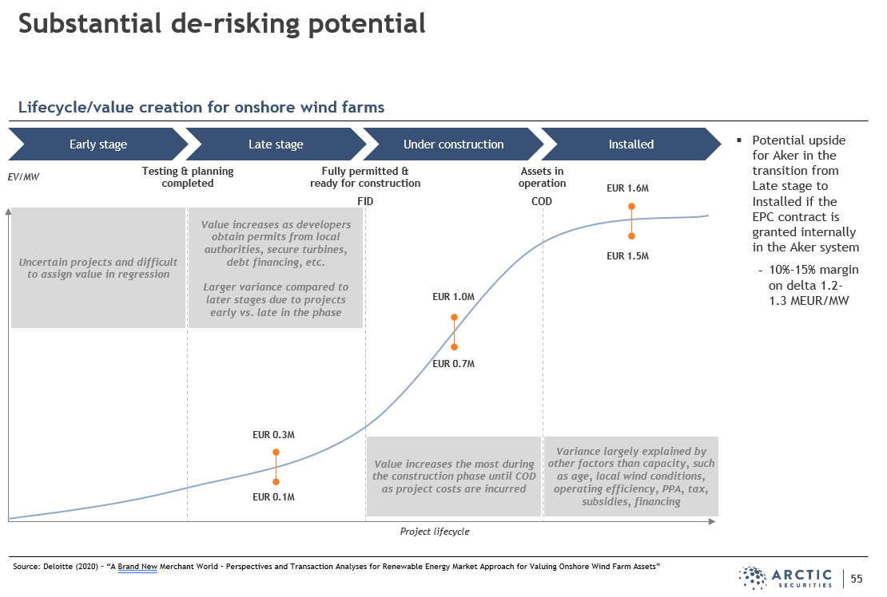
WindPark Builder

Slide 36
The problem 6
Concerns over the impact of wind farm (especially during construction) on the enviroment and communities around. This tool allows for the wind park and its potential benefits to be seen easily
WindPark Builder

Slide 37
Notes:
Icons (Transmitter)

Slide 38
Notes:
Icons (Wind turbine ECO)

Slide 39
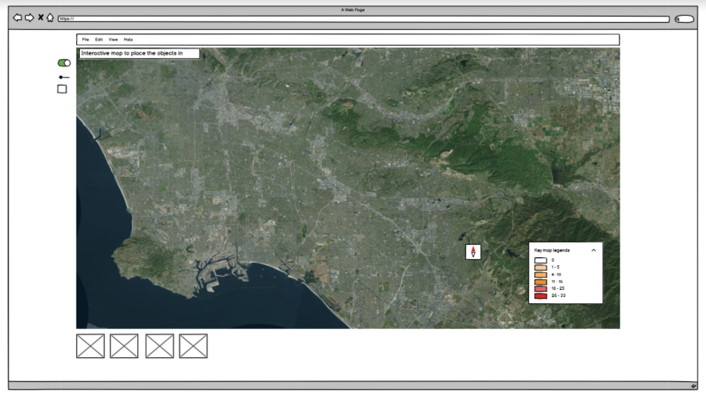

Slide 40

Project Development is costly
Different consultants work on the project and have all project related information in silos
Hardstand dimensions for land needs
Roads red line boundaries for land need definition (width of 4-6 meters)
Cable land need definition (per EIE) standards

Slide 41
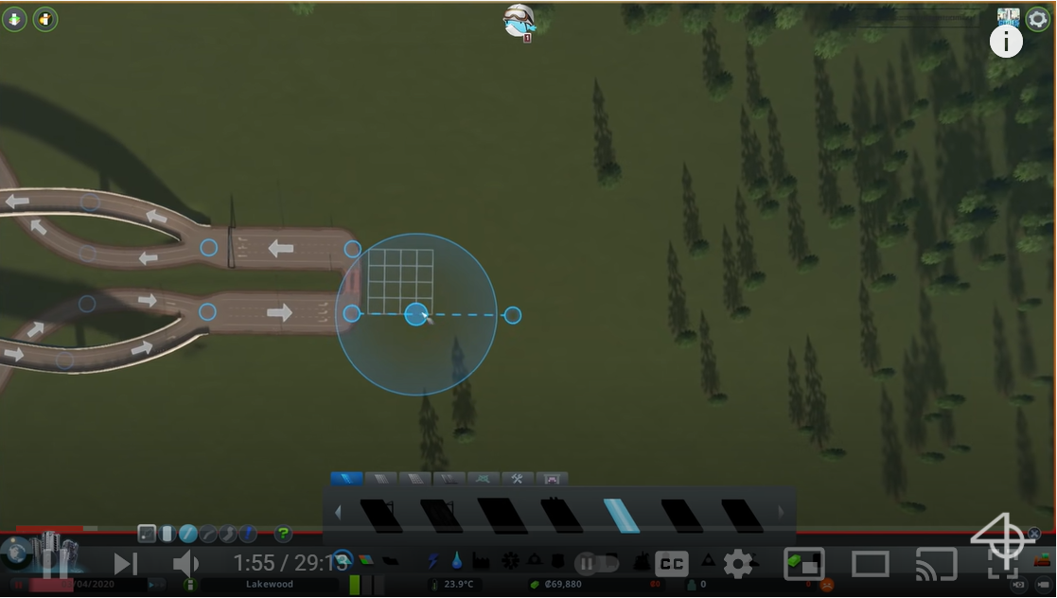

Slide 43
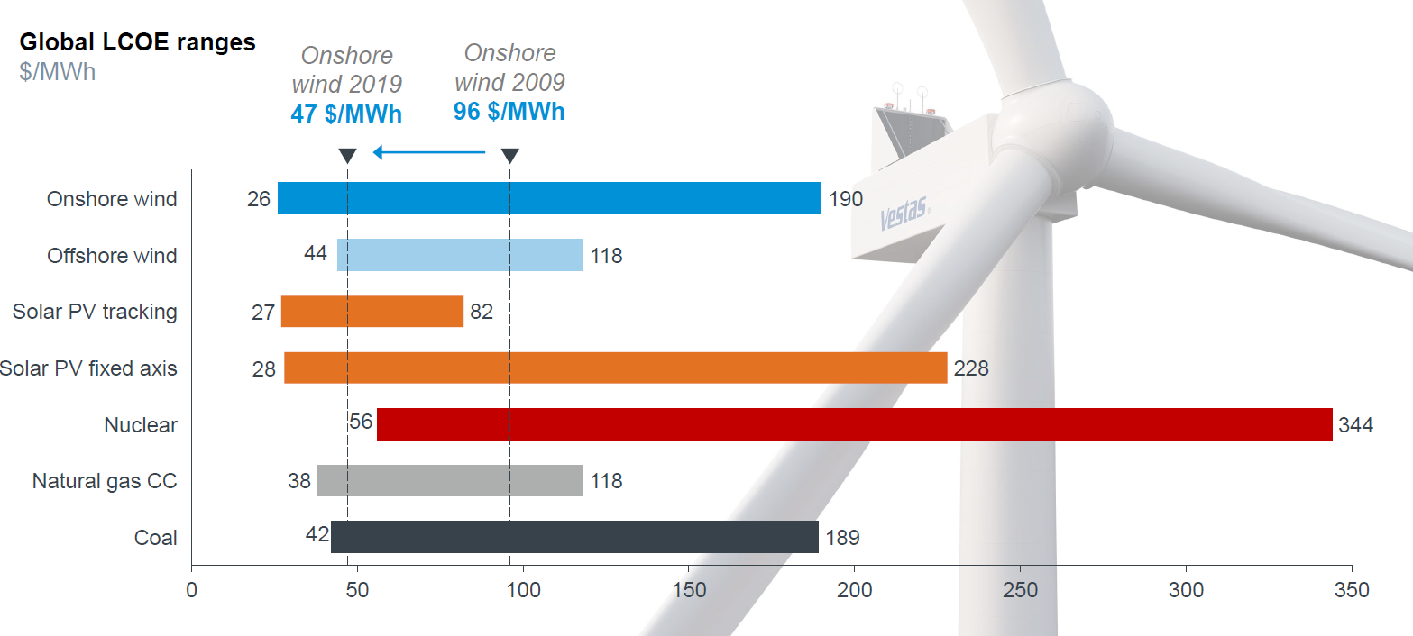

Slide 44
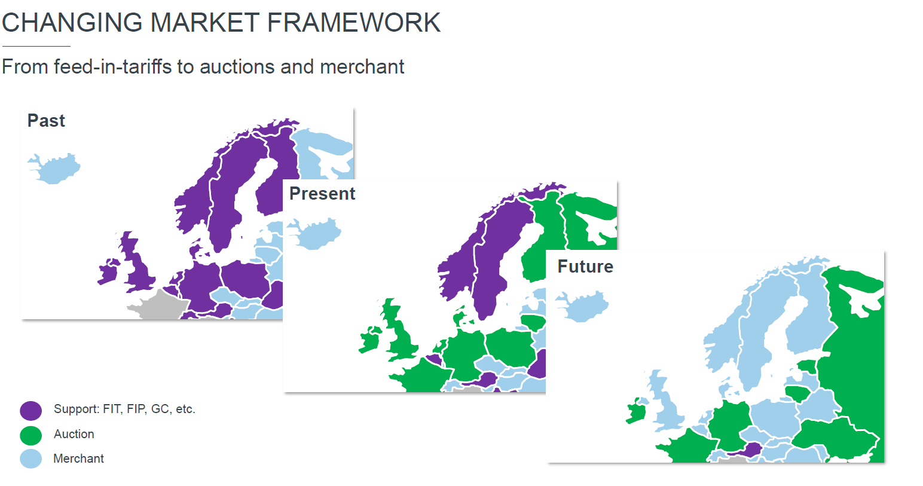

Slide 45
MilestRones
October 2014
October 2015
August 2015
November 2015
Translate web pages with Chrome extension
Translate text within an app
2014 |  |  |  | 2015
Translate conversations through your Android watch
Translate written text from English or German to Arabic with the click of a camera

Slide 46
What people are saying
With this app, I’m confident to plan a trip to rural Vietnam
Wendy Writer, CA
Visual translation feels like magic
Ronny Reader, NYC
Translate has officially inspired me to learn French
Abby Author, NYC
Quotes for illustration purposes only

Slide 47



Know a 2nd language? Make Google Translate even better by joining the community.
Tip
Inspire your audience to act on the information they just learned.
Depending on your idea, this can be anything from downloading an app to joining an organization.

Slide 48
Good luck!
We hope you’ll use these tips to go out and deliver a memorable pitch for your product or service!
For more (free) presentation tips relevant to other types of messages, go to heathbrothers.com/presentations
For more about making your ideas stick with others, check out our book!

